Slide 1
Trojan vault
Secure personal documents

Slide 2
As a customer…
I want to securely store my personal documents online
Passport
Driving Licence
Miscellaneous (Payslips, qualification certifications)
..With any necessary validation checks completed
..So I can easily prove my identification and/or provide any required documentation without the hard copy present.

Slide 3
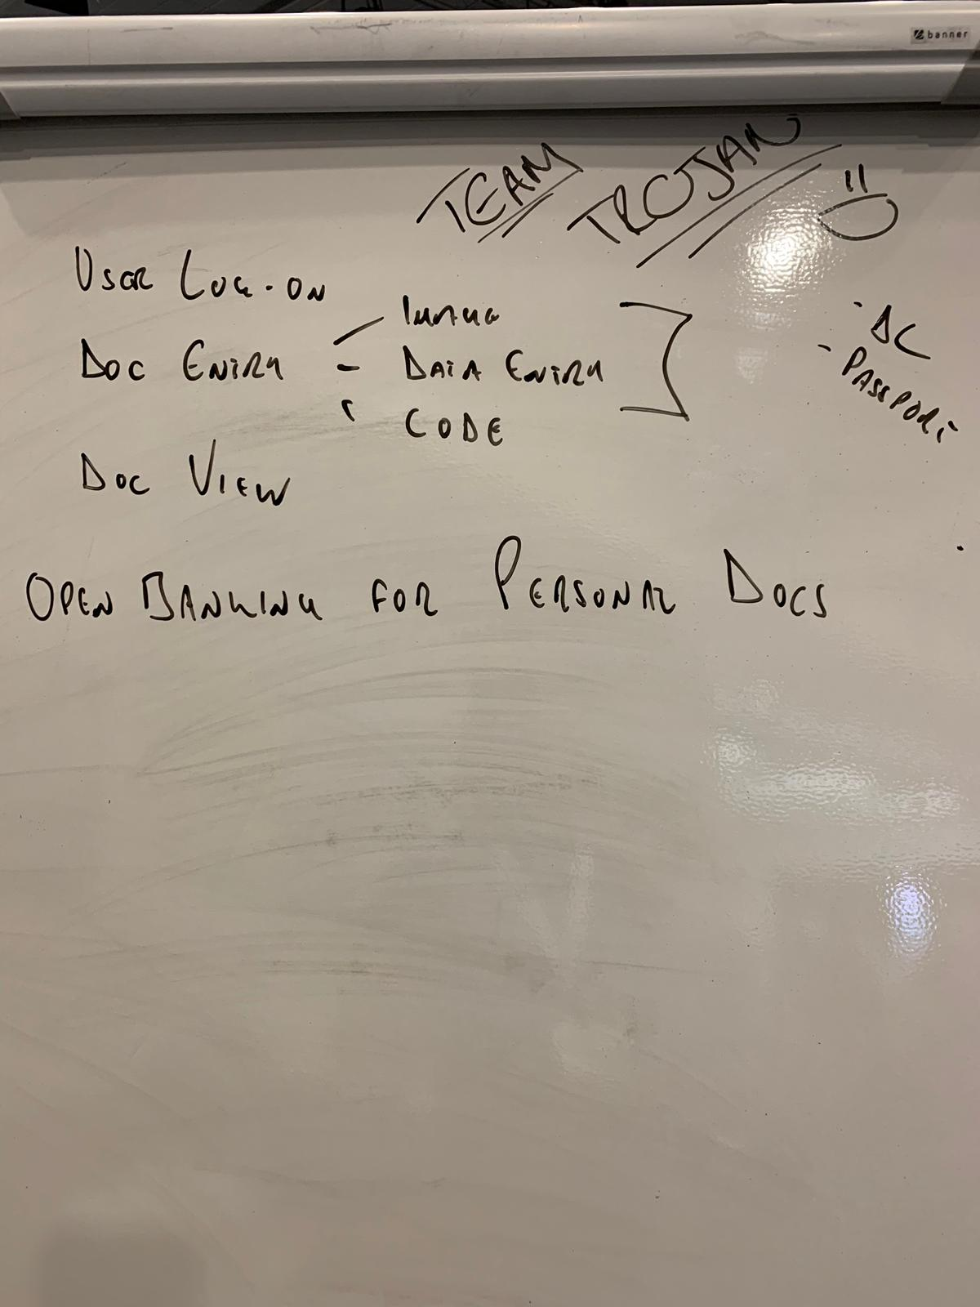
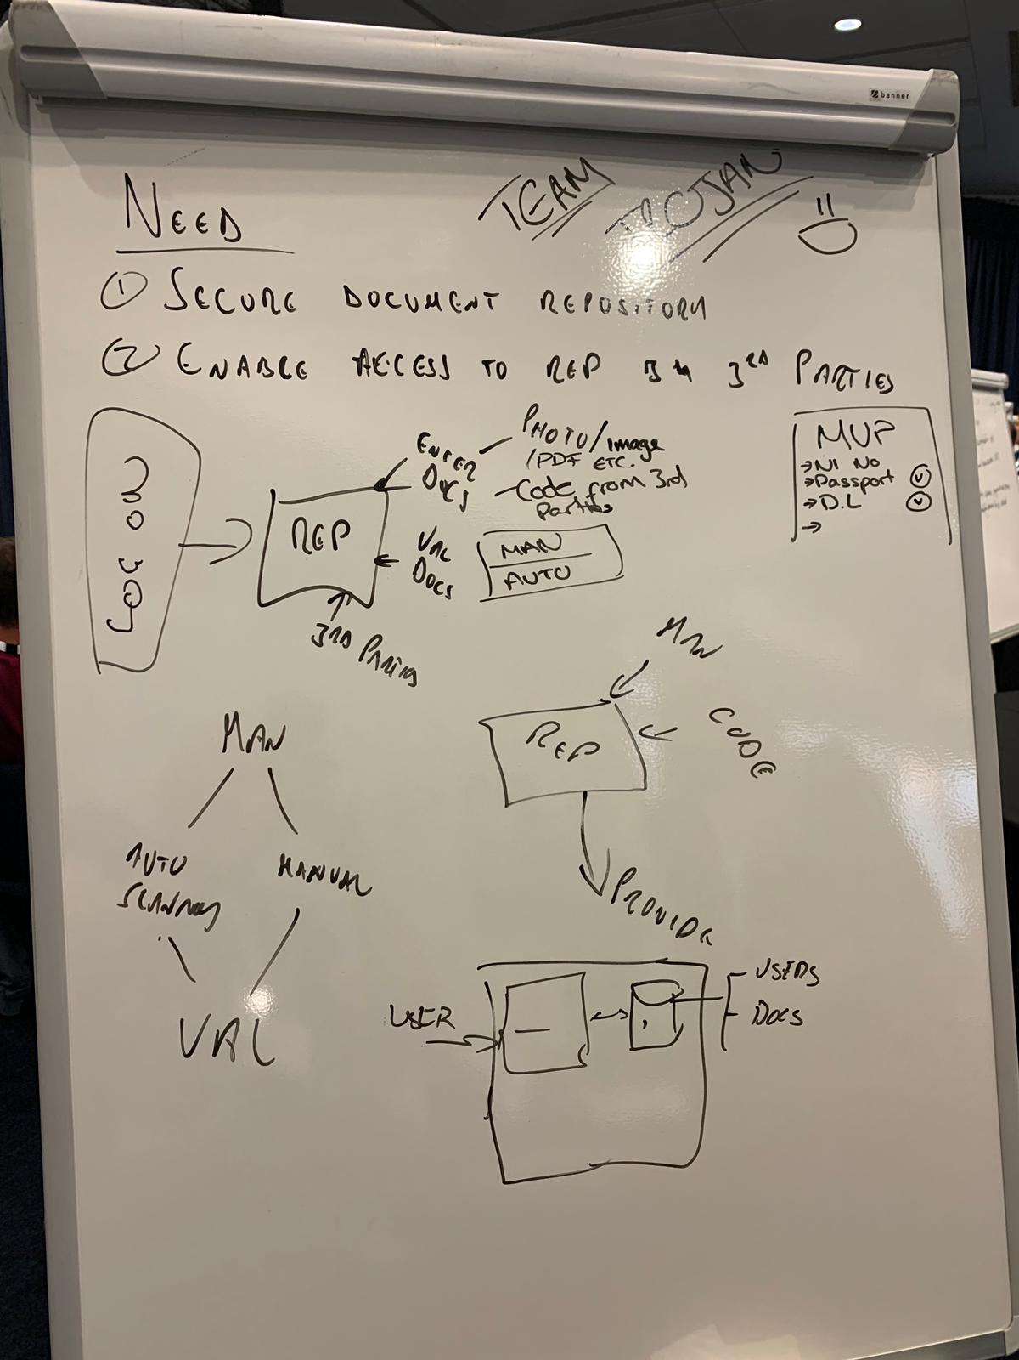
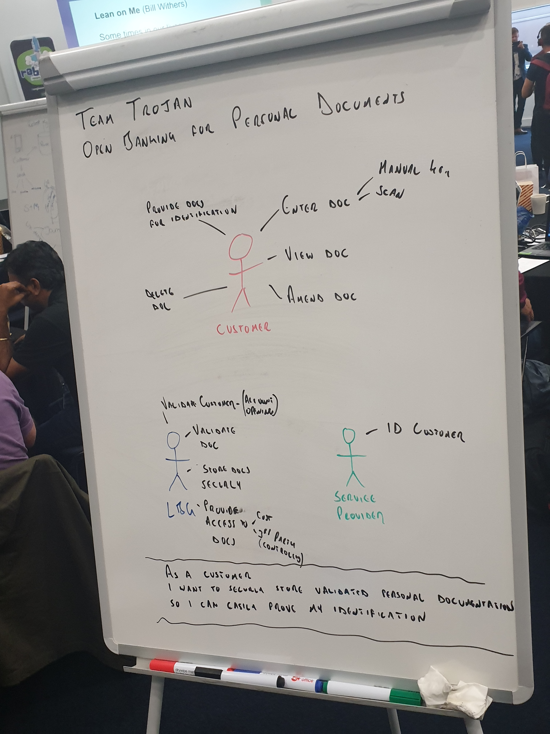
Use case

Slide 4




High level solution
User to login and upload documents in Vault.
Documents will be stored in Database for validation.
Upon successful validation, user will be notified.

Slide 5

UPLOAD VALIDATION PROCESS FLOW
TORJAN VAULT
UI REACT JS
AZURE COSMO DB
LOGIN
UPLOAD
VALIDATION PROCESS
CHECKS
VALIDATION RESULT

Slide 6

IDENTIFICATION PROCESS FLOW
TORJAN VAULT
01 DOCUMENT REQUEST
02 DOCUMENT SELECTION
04 CODE
03 CODE
05 DOCUMENT RETREIVAL REQUEST
06 REQUESTED DOCUMENTS

Slide 7
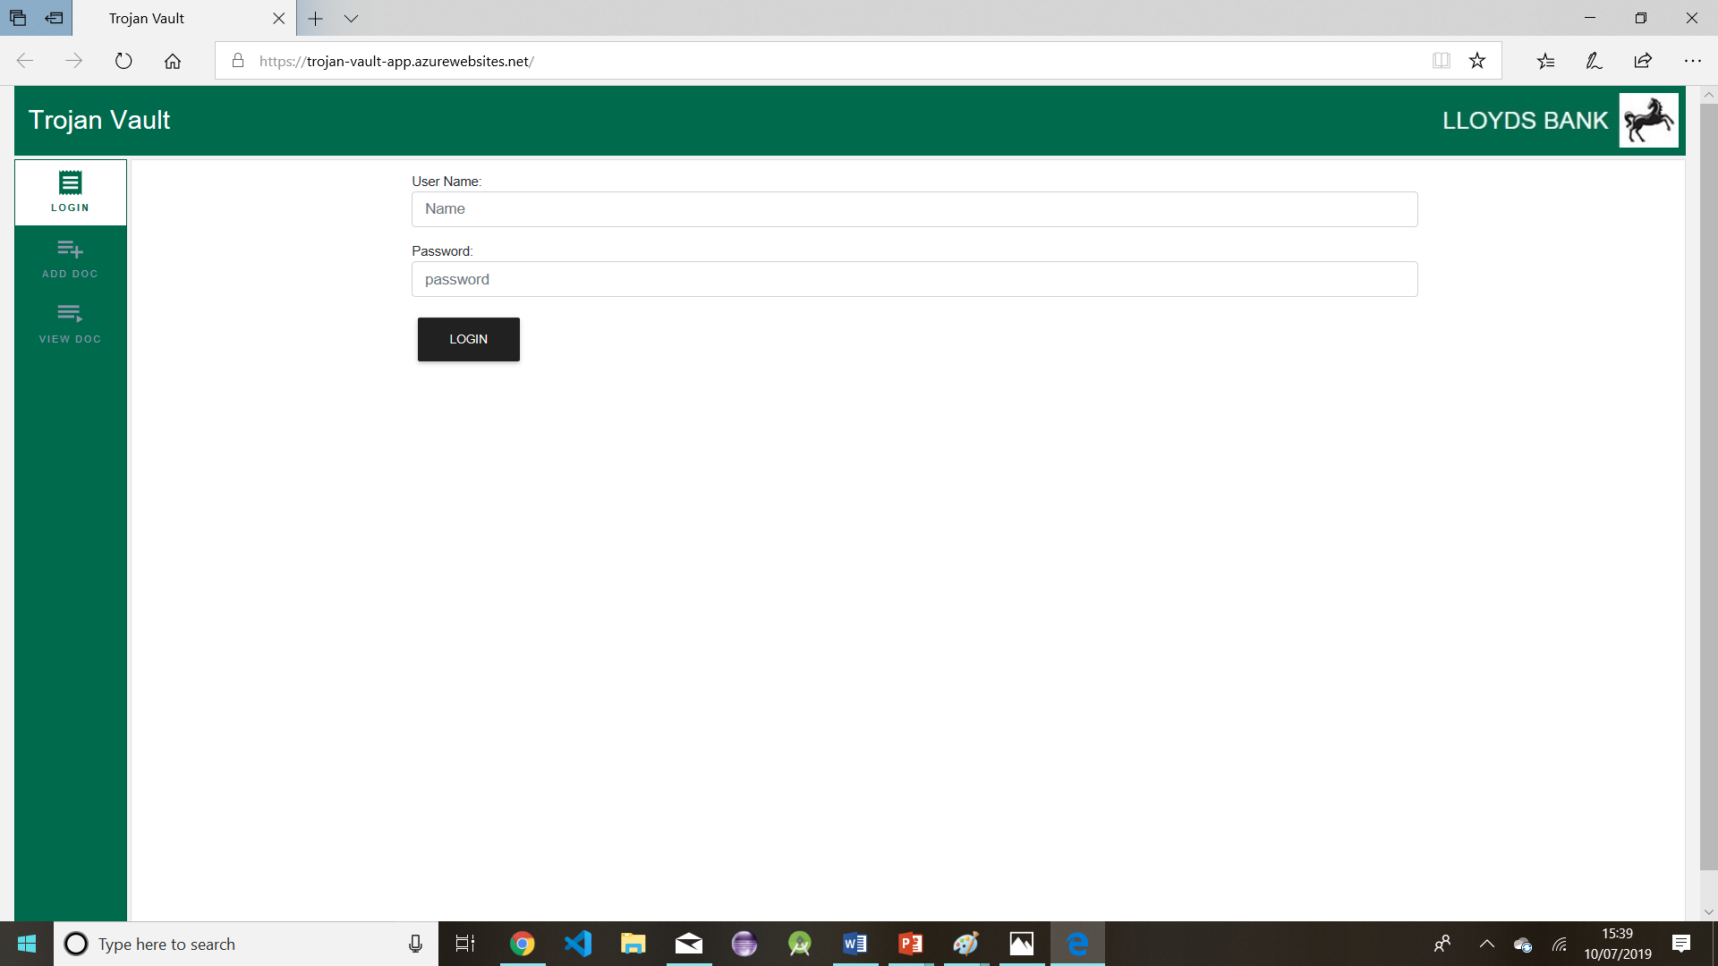
Web App – Trojan Vault

Slide 8
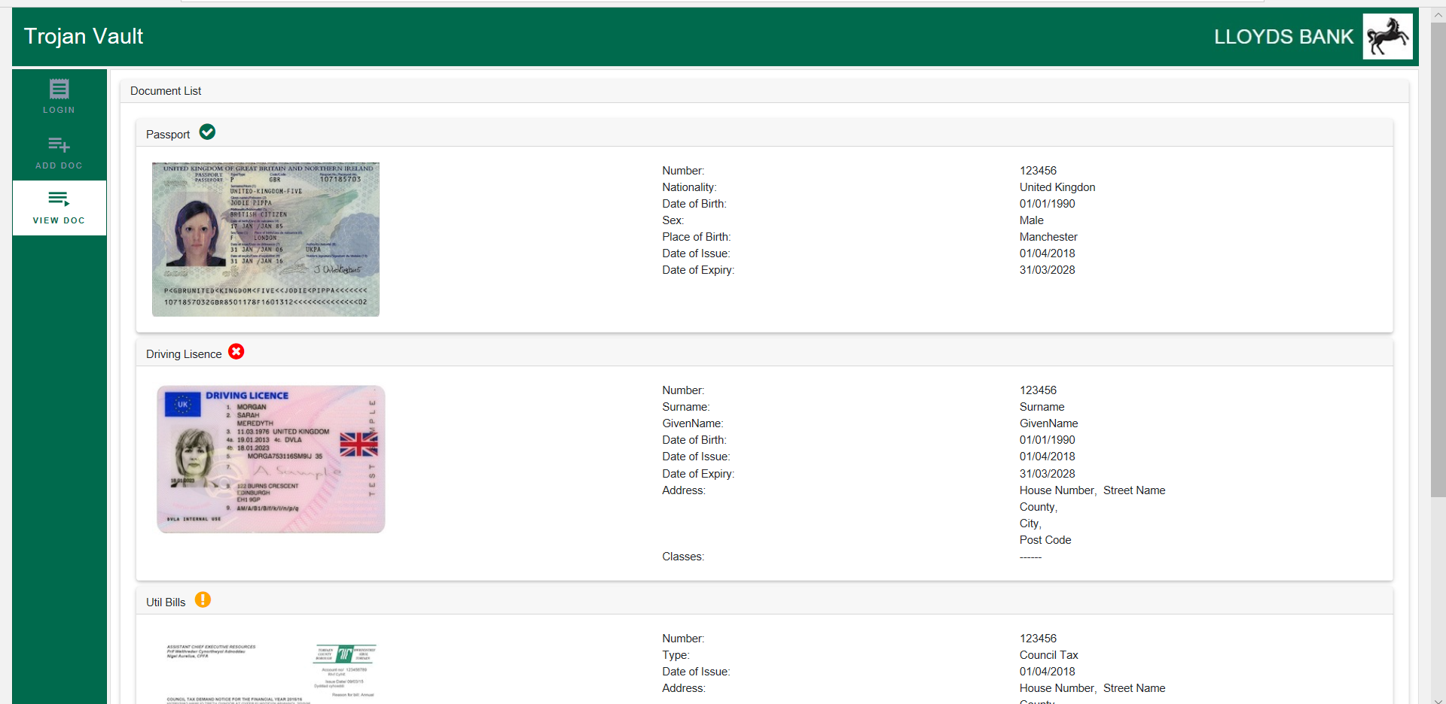
Web App – Trojan Vault

Slide 9
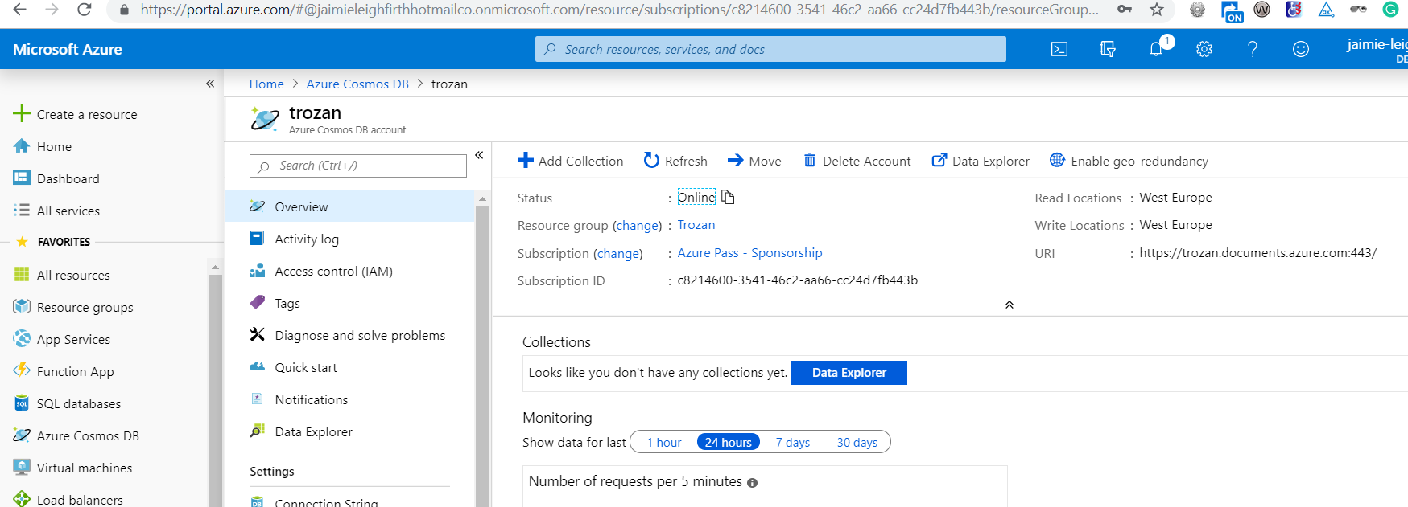
Cosmos DB

Slide 10
